Slide 1

Bike Share program
Svitlana Nazarchuk
Tasnuva Airen

Slide 2

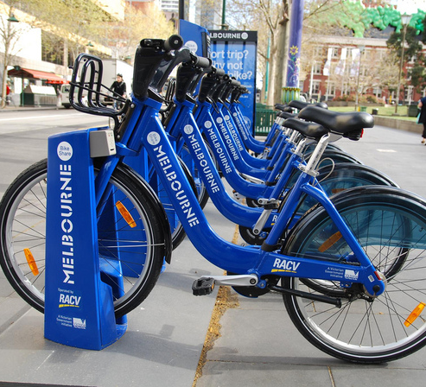
The idea of bike sharing program is to make bicycles available as an alternate and more environment friendly option to the regular public transports like train, bus, subway or taxi. There are various bike sharing options available all around the world; some are paid programs, and some are free. Some are located to specific docs and some are dock less.

Slide 3
Why Bike Share
User friendly
Environment friendly
Cheaper option
Flexibility
Popular in city like environment

Slide 4
Scope
Identify
Identify bike stations worldwide
Identify
Identify bike stations in New York City
Sort
Sort bike sharing company by country, city and company name
Display
Display a certain location on the map based on the sorted data
Analyze
Analyze bike sharing data of NYC from various perspective

Slide 5
Data Analysis process
Collect Data
Load Data into Database
Read and clean data
Analyze Data
Interpret and display with web visualization

Slide 6


Collect Data

Slide 7

Load Data into database

Slide 8





Data Analysis process
Bootstrap
CSS
html
Python
JavaScrip

Slide 9

Interpret and display with web visualization

Slide 10
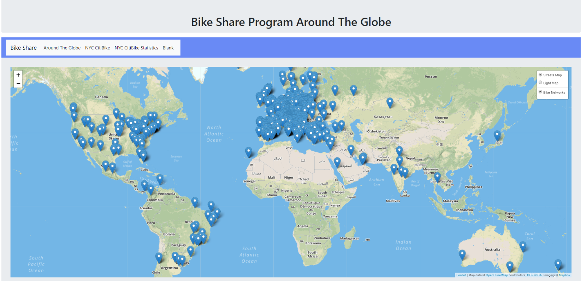

Slide 11
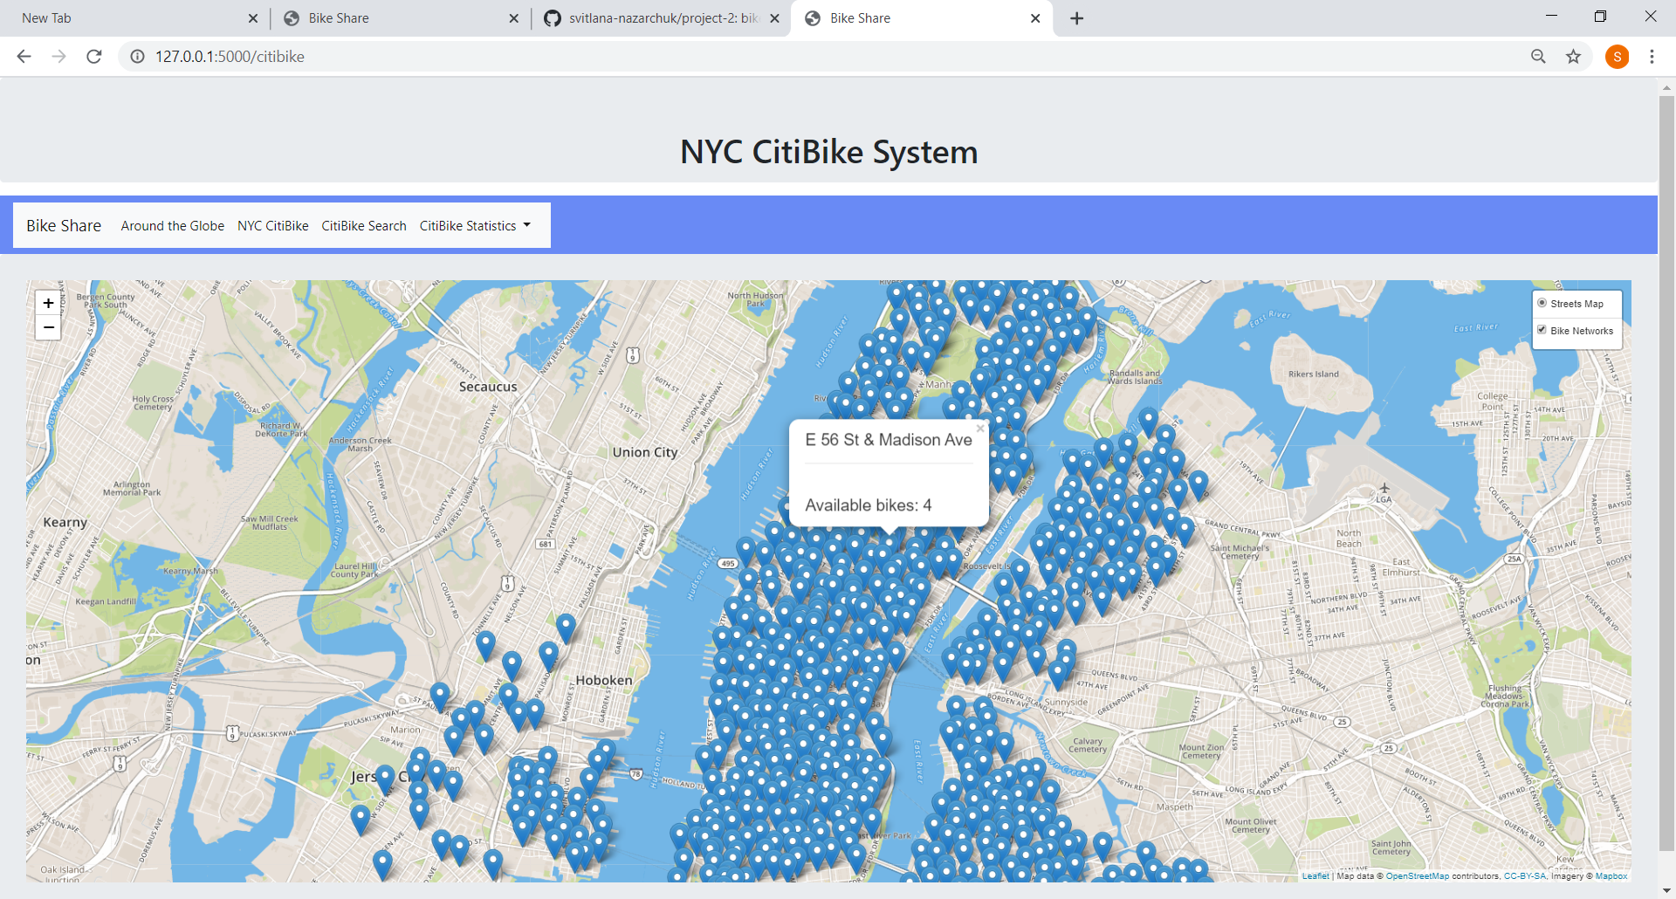

Slide 12
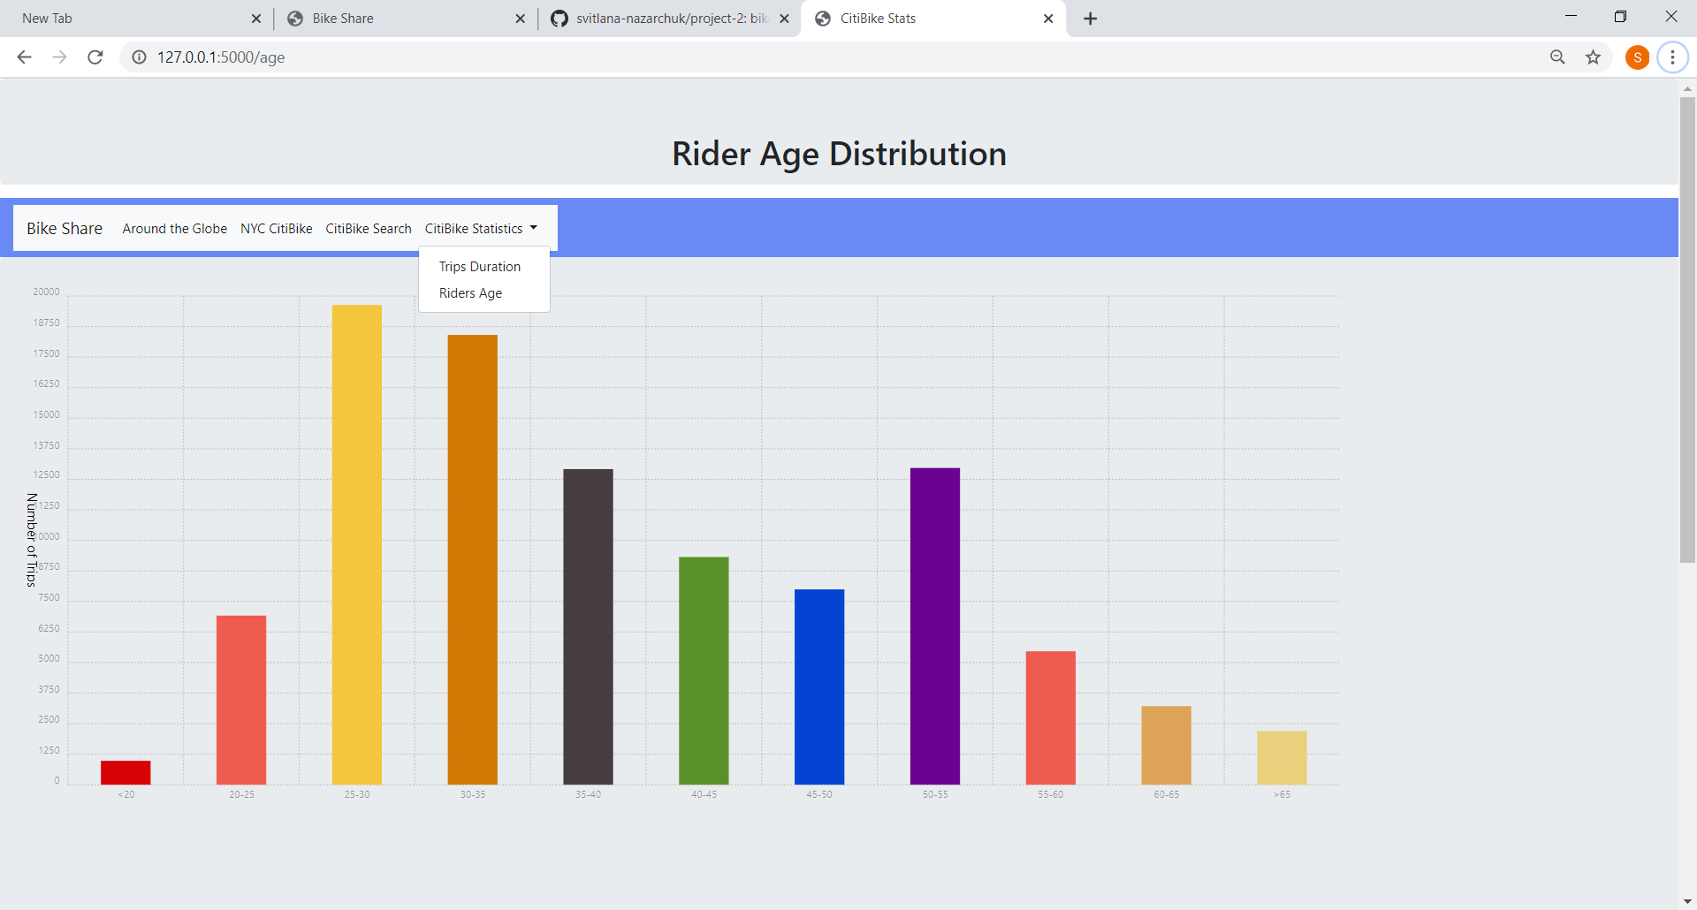
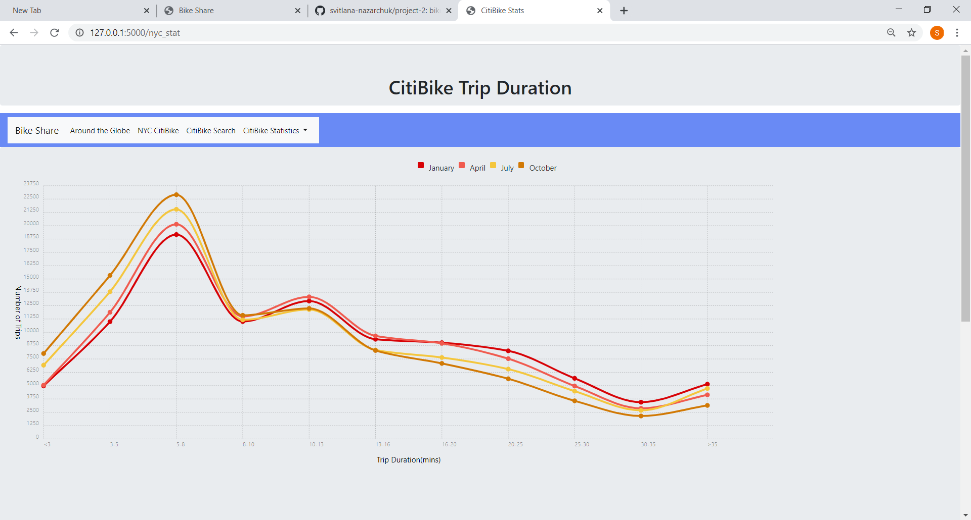
CITIBIKE Statistics

Slide 13
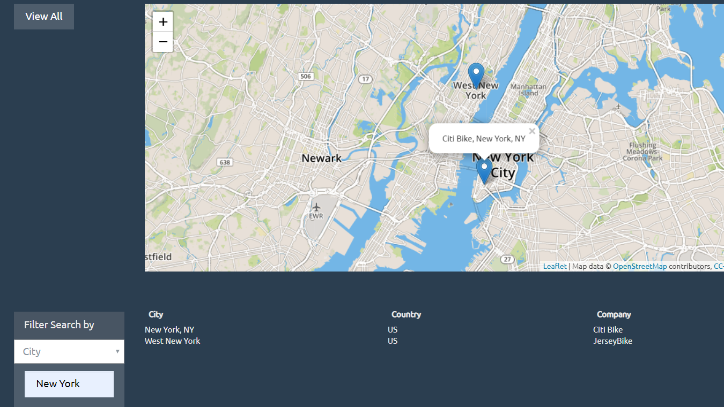
Country
City
Company

Slide 14
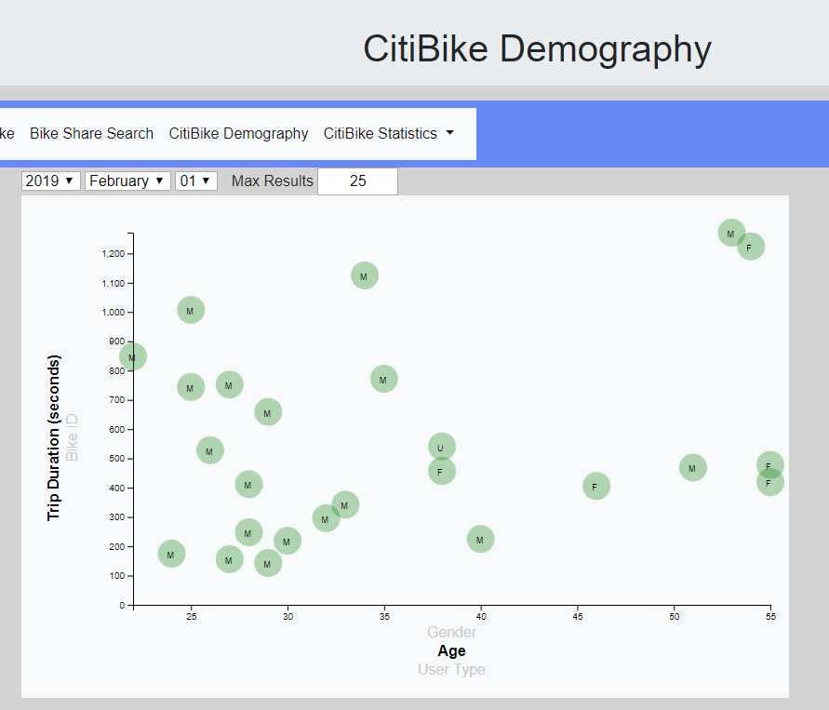

Slide 15

Questions?

